Slide 1
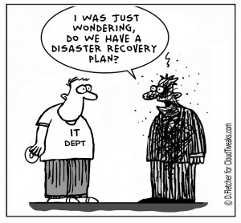

IT2775 Operations Security
BCP: Activation and Recovery

Slide 2
Objectives
P1. Activation Phase
  Initial Response
    Activation Triggers: Disruption Severity Levels
  Damage Assessment
  Disaster Declaration
P2. Recovery Phase
  Recovery checklist
  Recovery procedure
  IT Recovery and CIRT responsibilities

Slide 3

P1. Activation Phase
When: Addresses the time during and immediately after a business disruption
Who: Decision should be made by member(s) of senior management, preferably someone who is familiar with the plan.
What: Phase includes…
  Initial Response
  Damage Assessment
  Disaster Declaration

Slide 4
P1. Activation Phase
Initial Response:
  Receive initial notification of possible, impending, or in-progress disruption.
  Alert appropriate emergency response organizations (fire, police, etc.), if needed.
  Retrieve BCP plan, mobilize DAT and CMT.
  Assess severity level, determine appropriate BCP action plan based on activation triggers.
  Notify appropriate BCP team members.
  Prepare preliminary event report or log.
  Communicate with appropriate parties.

Slide 5
P1. Activation Phase
Activation Triggers:
  Defined in BCP to aid decision on when and how to activate plan.
  Circumstances and severity level before activating BCP.
  Major
    Disrupts all/almost all of the business-critical functions
  Intermediate
    Disrupts some business-critical functions but not all
  Minor
    Normal operations can still continue.
    Business-critical functions available for some time.

Slide 6
P1. Activation Phase
Damage Assessment
  Notified of disruption, review preliminary report.
  Assess structural damage, impact to health and safety.
  Determine extent and severity of disruption to operations, assess potential financial loss.
  Follow up actions based on severity level.
    Minor disruption:
      No further action, monitor situation.
    Intermediate or Major disruption:
      Prepare final assessment report, notify BCP team of findings.
      Declare disaster and update event logs
  Communicate with appropriate parties.

Slide 7
P1. Activation Phase
Disaster Declaration
  Review disaster level assessment, impact and other data gathered during initial response.
  Activate BCP teams if not already activated.
  Review recovery options based on assessment.
  Select best option(s), plan for the execution.
  Notify management and CMT.
  Prepare a disaster declaration statement for employees, BCP team and community contacts.
  Monitor progress, document results in event log.
  Communicate with appropriate parties

Slide 8
Communicate With Appropriate Parties
Communicate Relevant Information
  Critical to build understanding with all parties especially for incidents of sensitive nature.
Organization
Employees
Customers
Vendors
Shareholders
Public
Media
Law Enforcement Agencies

Slide 9
Activation Example
A power outage to a portion of the data centre event has occurred.
  Day-to-day operations are disrupted.
Initial assessment by employees on the scene.
  A portion of the network is or may be out of services
  1 or more critical servers are or may be out of service
  A portion of the physical facility has been impacted
  Unable to resume normal operations within 2 hours.

Slide 10
Activation Example
If disruption appears to be intermediate on initial assessment, within 2 hours …
  Gather information from emergency responders
  Activate damage assessment team
  Notify crisis management team to standby
After 2 hours from event notification, gather initial evaluation from damage assessment team (DAT).
After 3 hours, notify crisis management team (CMT) to activate or stand down.
Within 3 hours, execute BCP if assessment indicates intermediate or major disruption.

Slide 11

P2. Recovery Phase
What: Specific steps taken to get operations up and running again are defined in this phase.
  Evacuating facility
  Remove equipment that can be salvaged
  Assess situation or damage
  Determine which recovery steps to execute
  Alternate computing facilities may be activated
How:
  Recovery checklist: What are the items to recover?
  Recovery procedures: How to recover item?
Recovery Time Objectives

Slide 12
P2. Recovery Phase
Recovery Checklist
  To guide various teams on what to look out for during the recovery process.
  Useful to divide into specific areas
    Infrastructure
    Applications
    Office-area and end-user recovery
    Business process recovery
    Manufacturing, productions, operations recovery

Slide 13
P2. Recovery Phase
Recovery Procedures
  step-by-step documentation to guide recovery of a specific item or asset.
  How:
    created for the particular setup in the organization – no standard procedure.
    assigned to the appropriate recovery team.
    written in a straightforward and clear manner.

Slide 14
P2. Recovery Phase
List of recovery procedures
  Obtain authorization to access damaged facilities and/or geographic area
  Notify internal and external business partners associated with the system
  Obtain necessary office supplies and work space
  Obtain and install necessary hardware components
  Obtain and load backup media
  Restore OS, application software to known state
  Test system functionality including security controls
  Connect system to network/other external systems
  Operate alternate setup

Slide 15
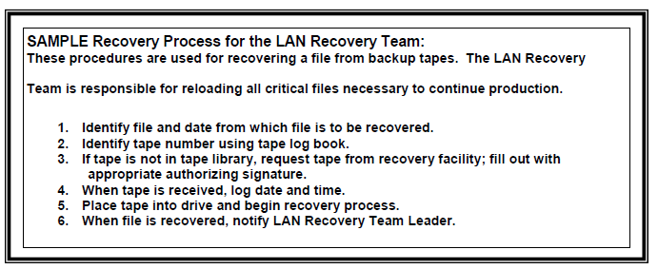
P2. Recovery Phase
Sample recovery procedure

Slide 16
P2. Recovery Phase
IT Recovery
  Requires specialized knowledge and training.
  Organizations employ Computer Incident Response Team (CIRT) for this. CIRT Responsibilities:
    Monitor
      Monitor IT infrastructure for abnormal events or incidents that may require response.
    Alert and mobilize
      Once an event is suspected /confirmed, need to mobilize appropriate team members for action.
      May include shutting down servers, applications such as email servers and services.

Slide 17
P2. Recovery Phase
    Assess and stabilize
      Assess the damages and take steps to contain them to bring about stability to the situation.
      Typically the longest phase due to complexity.
      Take into account Maximum Tolerable Downtime (MTD).
    Resolve
      Take steps to resolve the issues caused by the event.
      Exact steps depend on the nature of the damage and the resources that are available at that time.
    Review
      Study and assessed what has happened and document of lessons learnt for future reference/training.
Hot, Warm, Cold Site

Slide 18
Summary
P1. Activation Phase
  Initial Response
    Activation Triggers: Disruption Severity Levels
  Damage Assessment
  Disaster Declaration
P2. Recovery Phase
  Recovery checklist
  Recovery procedure
  IT Recovery and CIRT responsibilities

Slide 19
Additional References

Slide 20
Disruption Severity Levels
Major Disruption
  Low likelihood but high business impact.
  Disrupts all or most of the critical business processes/functions of the organization.
  Typically, all or majority of the systems and equipment have failed or are inaccessible.
  Examples include earthquake, tsunami, war

Slide 21
Disruption Severity Levels
Intermediate Disruption
  Likely to occur more frequently than major incidents but less than a minor incident.
  Impact is between major and minor incident.
  Some operations will experience significant disruption, such as entire systems or multiple systems failing or becoming unavailable.
  Examples include a fire or flood in the building that impacts IT systems and equipment.

Slide 22
Disruption Severity Levels
Minor Disruption
  High likelihood but the associated impact is low.
  Effects are typically isolated to a component, system or segment of critical business function.
  Normal operations can often continue, almost uninterrupted, in the face of a minor disruption.
  Critical business functions still continues for some period of time after this type of disruption.
  BCP/DR plans are rarely activated but there may be examples where minor incidents should be addressed by the activation of part of a BCP.

